Slide 1




DIGITAL LITERACY
SKILLS
INTERMEDIATE USERS

Slide 2
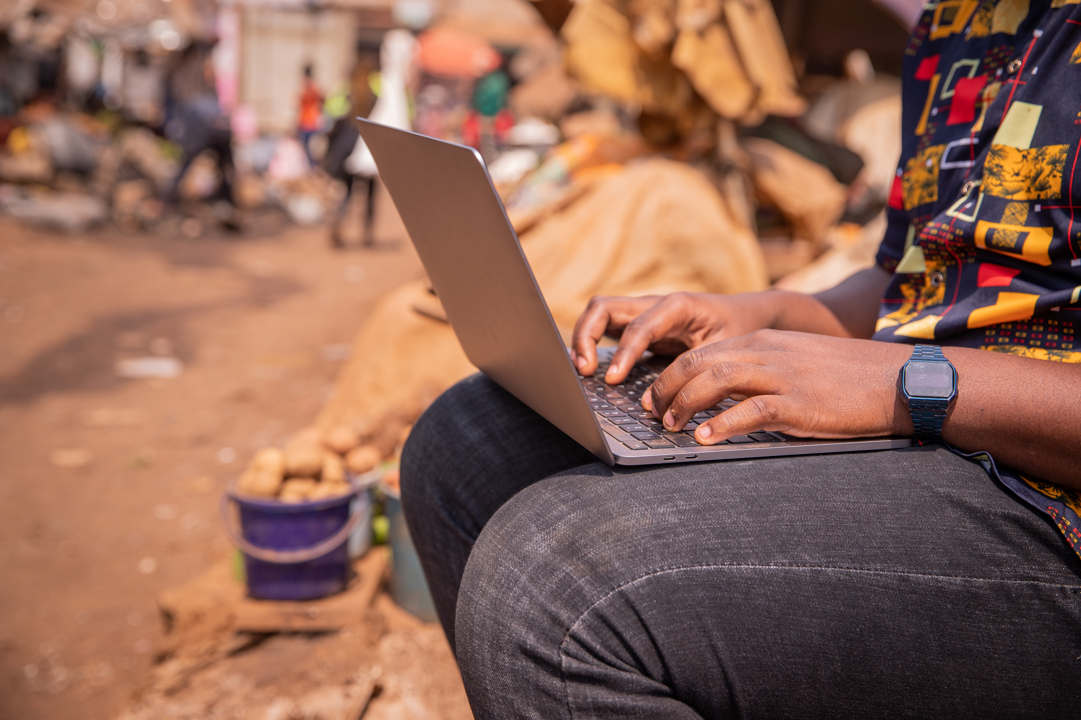
Module 3
Communication
and collaboration

Slide 3

7
Unit 7: Managing digital identity

Slide 4
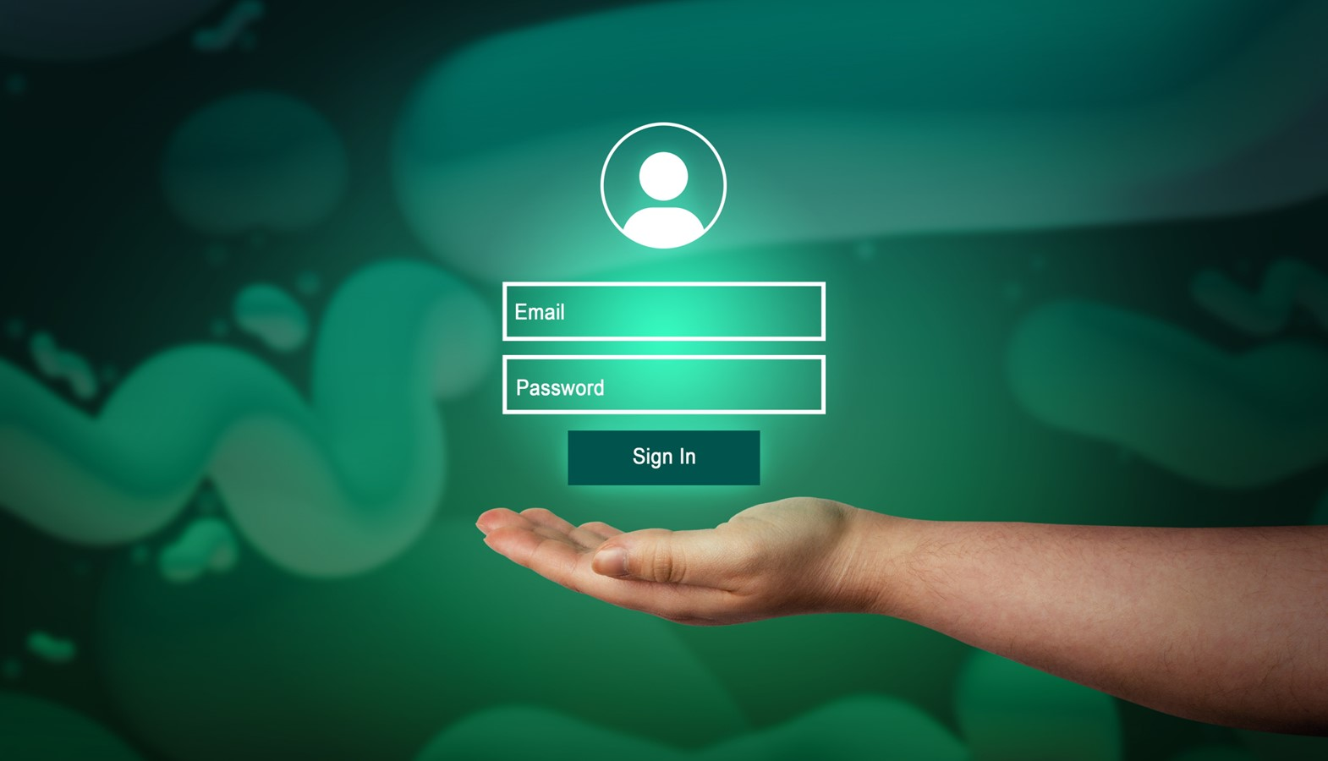
Definitions and protecting identity
The information we leave online about ourselves represents our digital identity. For example, when we use a username and password to authenticate ourselves on a website, we are using our digital identity.
Many services require us to log in from devices. E-commerce, banking, health services, tax services are just a few examples.
Our private data are taken and recorded, often without you even realising it. Therefore, you need to be aware and learn how to best manage your digital identity.

Slide 5

Definition of managing digital identity
Managing digital identity means:
“To create and manage one or multiple digital identities, to be able to protect one's own reputation, to deal with the data that one produces through different digital tools, environments and services”.

Slide 6
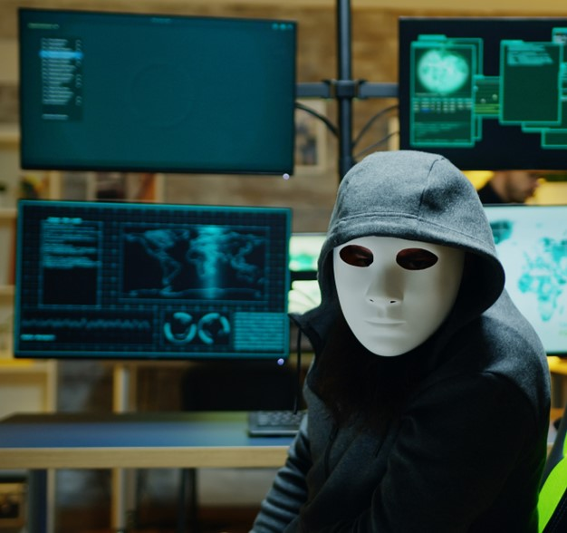
Identity theft
Cybercriminals hack and steal our personal or financial data.

Slide 7
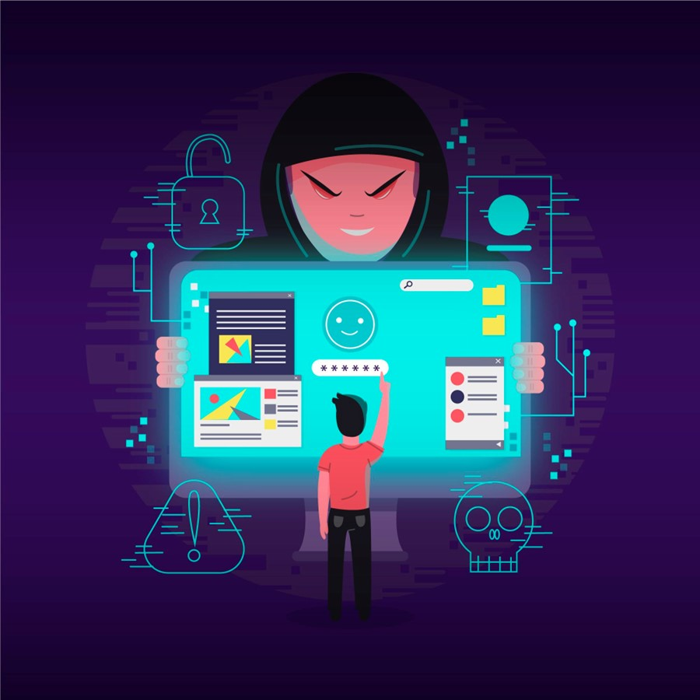
How to defend ourselves against cybercriminals
Be very careful when using the internet. Never open suspicious emails or messages. You need to be able to recognize whether the information you receive is true or not.
Ask:
Is it written correctly in your language?
Are there any strange signs?
Does it talk about operations of which you are not aware?

Slide 8
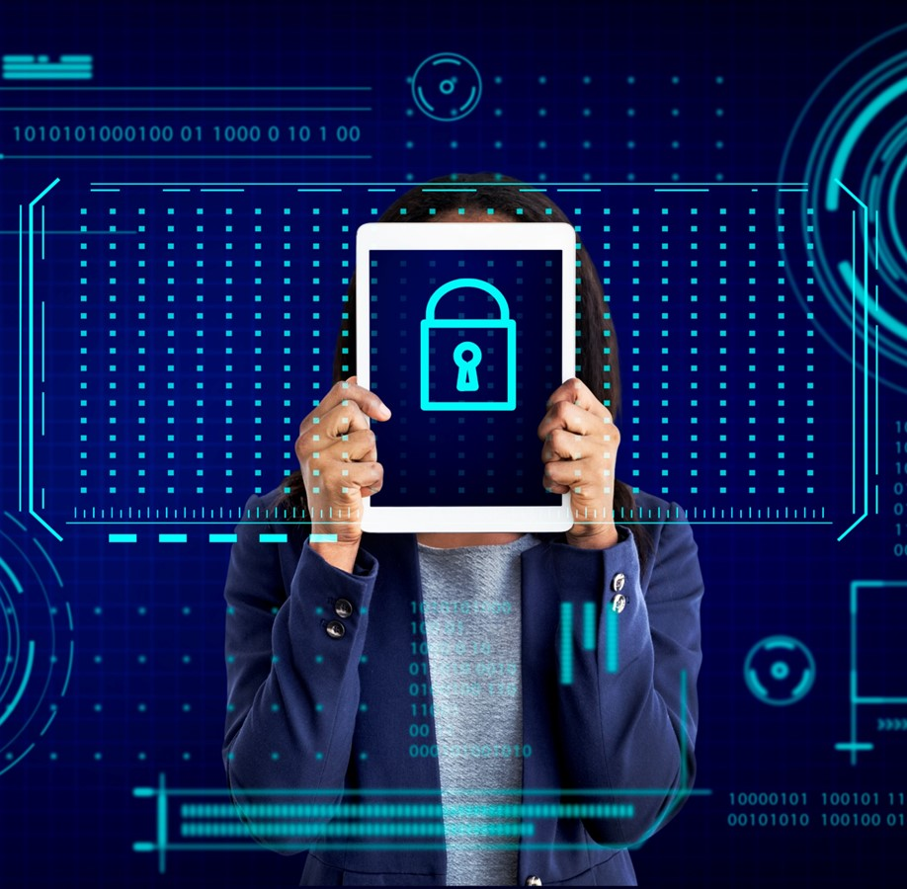
Ways to protect our digital identity
Use two-factor authentication
Change and diversify passwords
Avoid sharing sensitive information

Slide 9
Skills to practise
Display a variety of specific digital identities.
Create a list of the different ways that you interact using the internet. The list could include:
online searches
use of google drive
social media apps
email.
Discuss specific ways to protect your reputation online.
Each of the digital identities listed above will create a digital footprint. Create a list of what to avoid if you would like to have a positive digital footprint.
Continue >

Slide 10
Skills to practise
Manipulate data I produce through digital tools, environments, or services.
Open your internet browser and delete your search history.
Change your password used to login on any app you use.

Slide 11
All back covers should include
contact information of the section
producing the work.
© United Nations Children’s Fund (UNICEF) [month and year of publication]

